Slide 1
Welcome to
SDP Training - Session 01
SDP Support Team:
Melinda Kulick, Jill Walker, Cathy White
sdpsupport@icarnegie.com
Notes:
Welcome to the first session of your training in SDP__ - today, we will be covering all of the logistics and starting knowledge you will need to kick off your training in the course.

Slide 2
Agenda
Next Training Cohort – SDP05-SDP08
Training Dates
LMS Overview
Access & Navigation
Course Structure & Course Documents
Project Material Layouts
SDP Course Overview
Instructor Training Resources
Instructor Training Syllabus
Instructor Training Workbook Part 01
Support contacts
Communication & Support Expectations
Next Steps
Open Forum
Notes:
The following are the different items we’ll be covering in today’s meeting.
You will have a chance at the end to ask general questions or to ask questions from the course’s project manager.

Slide 3








Next Training Cohort
SDP05
  Architecture and Design
SDP06
  Database and Client/Server Applications
SDP07
  Human Computer Interaction and Communication
SDP08
  Project Management
Notes:
Instructors will be training in one or more of the courses listed here.

Slide 4
Training Session Dates
Training lasts 4 weeks
Start Date: November 12th
Certification Exam available the week of December 3rd
End Date: December 26th

Slide 5
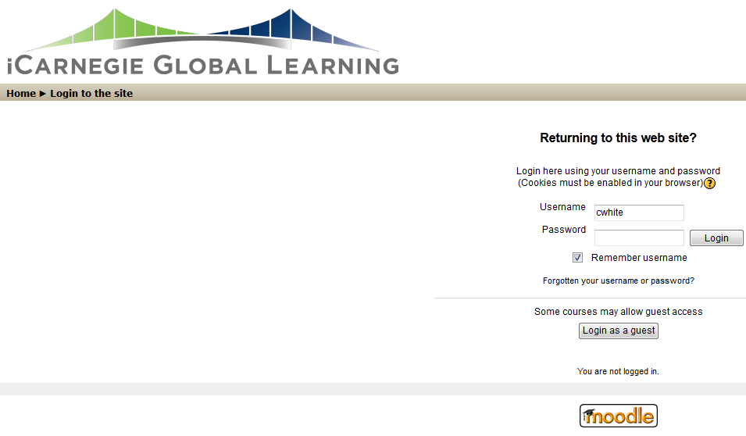
LMS Overview
What is an LMS?
What is Moodle?
What is Trestle?
Starting out in Moodle
Notes:
What is an LMS? Learning Management System. Explain that course materials and access to these will be available here. Will have access to two, Moodle and Trestle. Eventually, their students will also have access to the LMS (Trestle).
What is Moodle? Moodle is an LMS that we are currently using.
What is Trestle? Trestle is the LMS that we will be going to. They will be notified of the transition when it is ready. Students will have access to Trestle.
Starting out In Moodle – Discuss how we will currently use Moodle and what the end result will be (hopefully) by the time their shadowing phase begins.

Slide 6
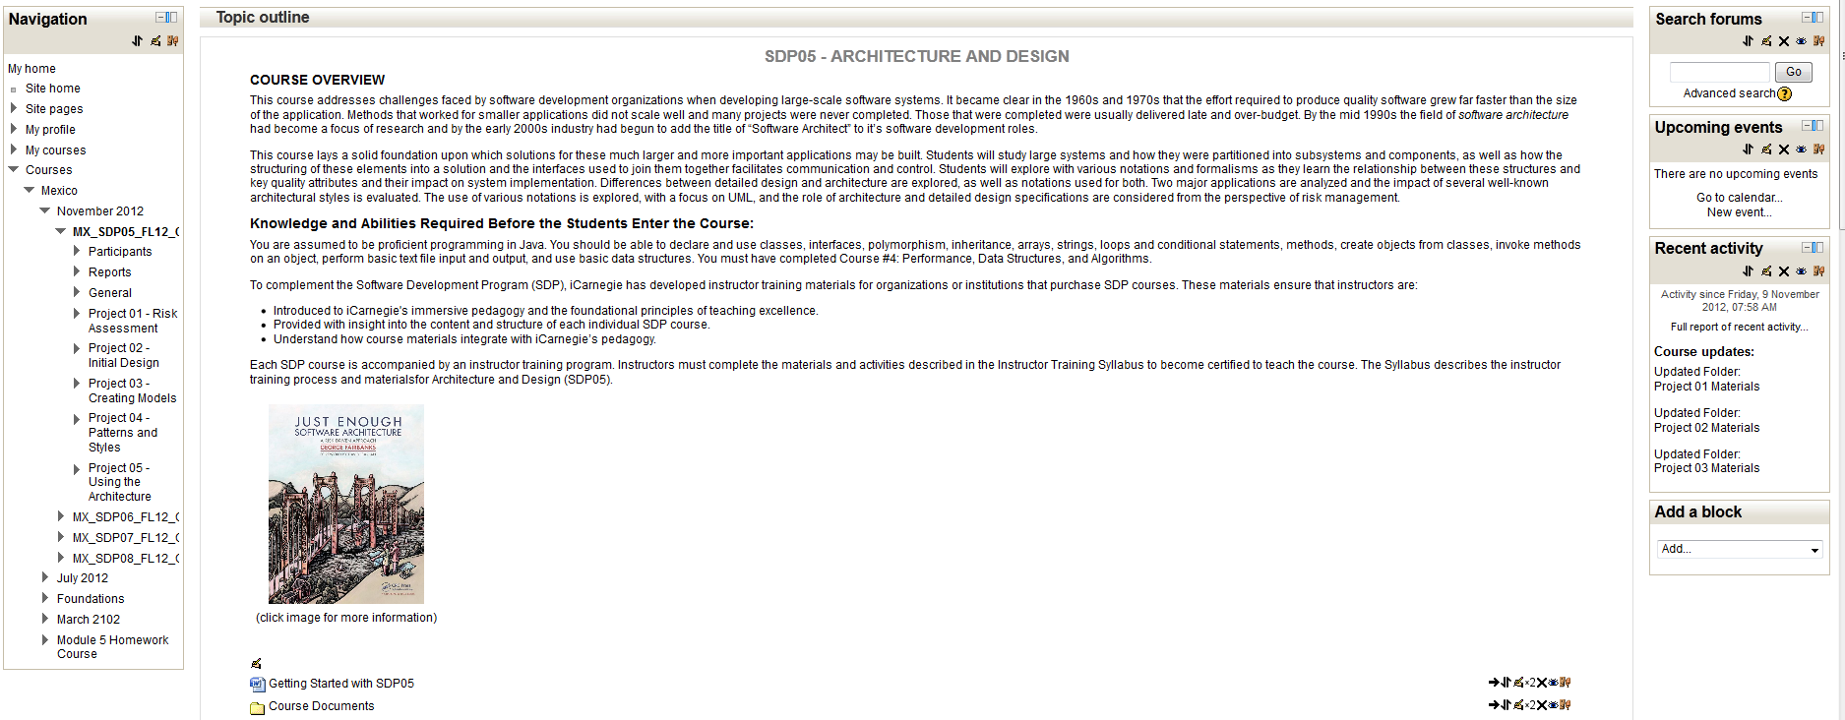
Access & Navigation
Notes:
When you log into Moodle, you will click on your course and this is what you will generally see upon your login.
**Talk through the screen
- Navigation on left
- Main page
- Search forums
- Activity on the right

Slide 7
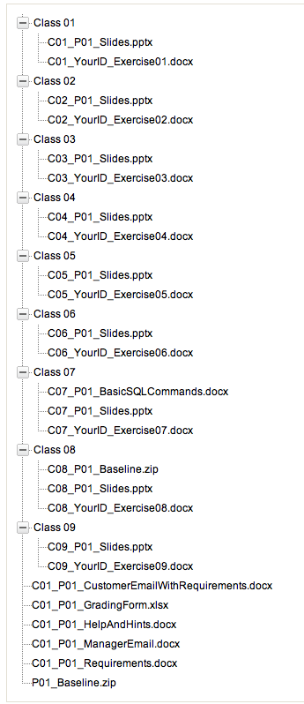
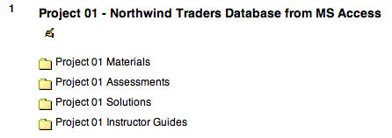
Course Structure
Each course contains activities:
Projects
Exercises
Assessments
Course Hierarchy consists of:
    Course
      Project
        Class
          Exercises
Notes:
Course Structure and Instructor Resources
Course Hierarchy:
Course
Project
Class
Exercises
Exercises lead up to the skills needed to complete the project and allow for collaboration with other students and the instructor.

Slide 8
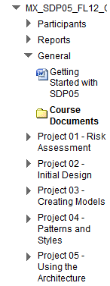
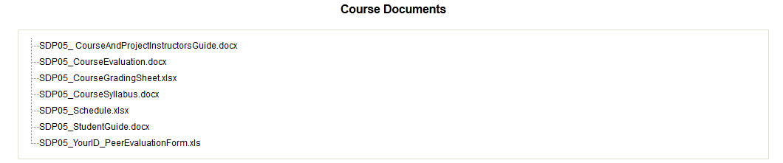
Course Documents
Course Documents
  Course Schedule
  Course Syllabus
  Course and Project Instructor Guide
  Course Grading Sheet
  Course Evaluation
  Course Student Guide
Notes:
Point out Course Documents in the navigation
Discuss what documents are found within the Course Documents folder as listed above

Slide 9
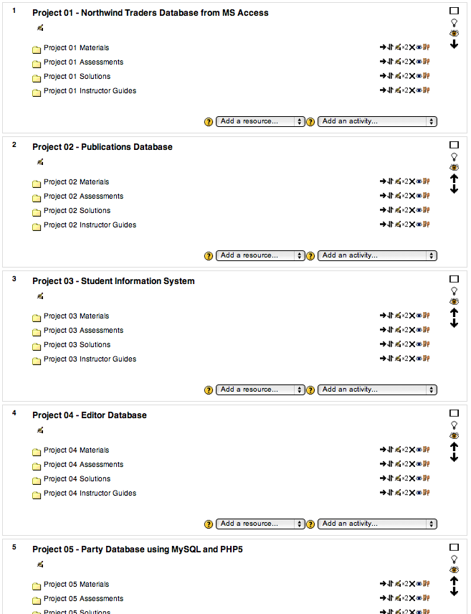
Course Projects
Notes:
**Talk through the screen
- Main page
- Project listings underneath course description on main page

Slide 10
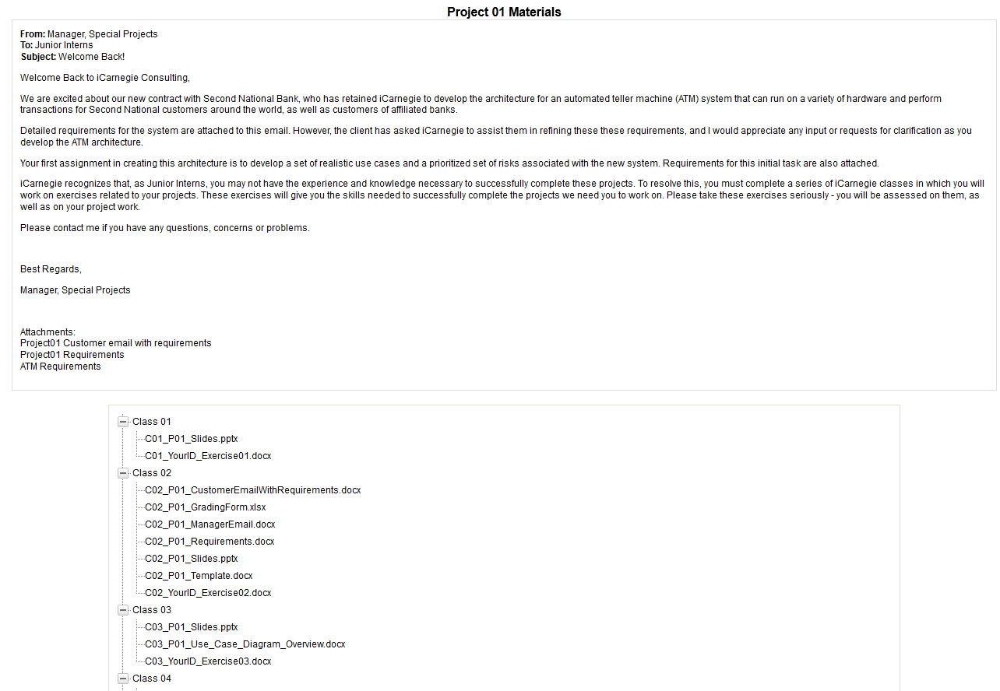
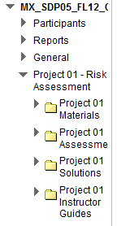
Project Materials
Notes:
Talk through the screen

Slide 11
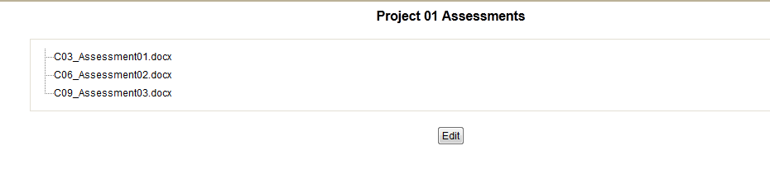
Project Assessments
Notes:
Talk through the screen

Slide 12
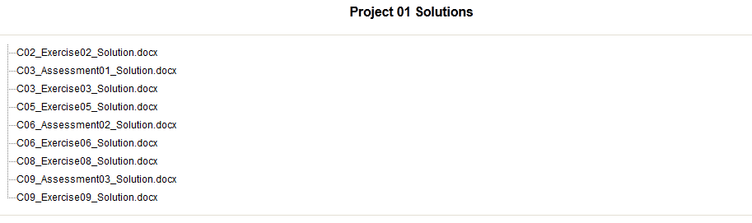
Project Solutions
Notes:
Talk through the screen

Slide 13
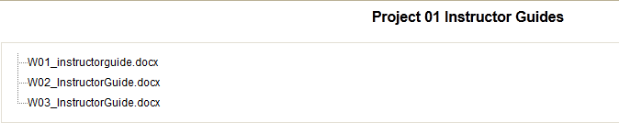
Project Instructor Guides
Notes:
**Talk through the screen

Slide 14
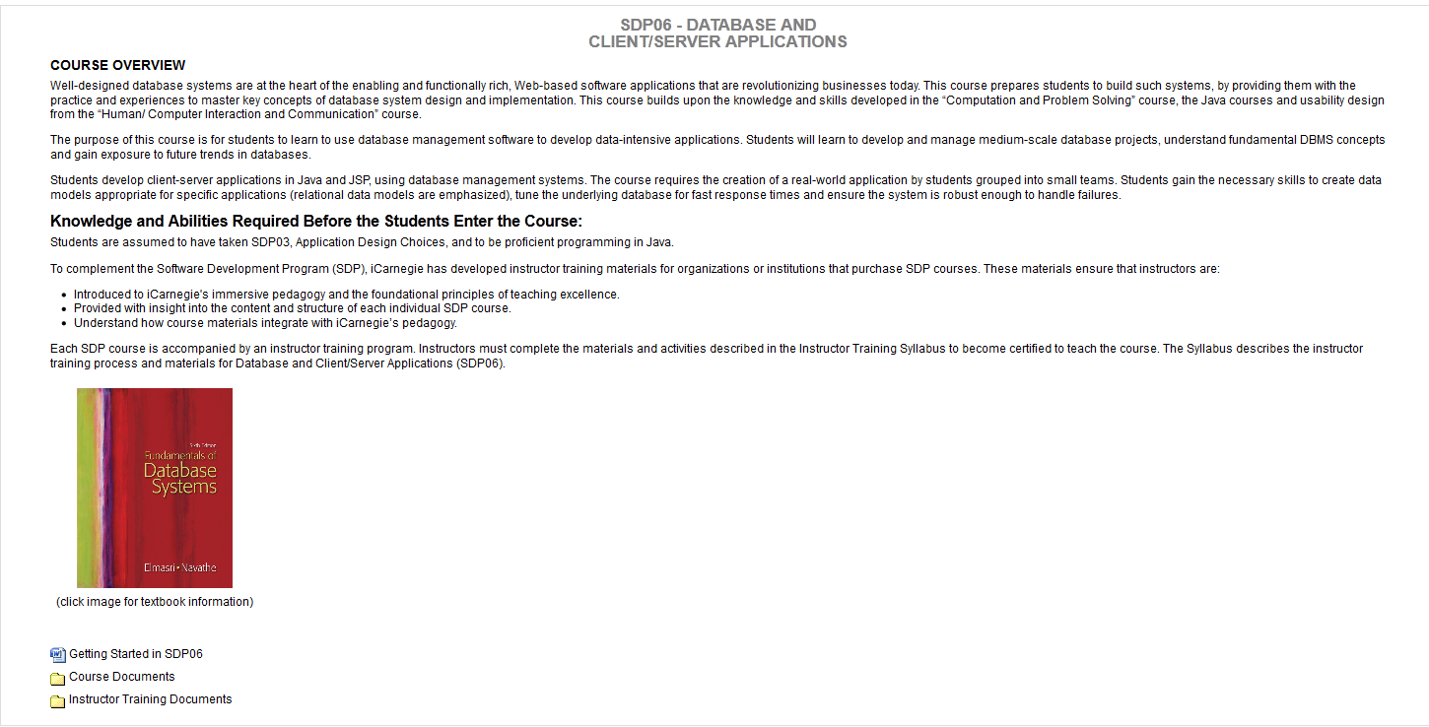
Instructor Training Resources
Tools for the instructor:
Instructor Training Syllabus
  Student view vs. Instructor view
Instructor Training Workbook
Notes:
Describe the purpose of the syllabus and the instructor training workbook.
Point out where it is on the home page of the course.

Slide 15
Instructor Training Syllabus
Consists of:
      Course Overview
      Learning Outcomes
      Textbooks
      Class Format and Setup
      SME Sessions
      Course Materials and Activities
Notes:
Instructor Training Syllabus
- Discuss what each of these items are briefly in general
Course Overview
Learning Outcomes
Textbooks (from Prerequisites)
Class Format and Setup
SME Sessions
Course Materials and Activities

Slide 16

General Class Format and Setup
SDP05, SDP07, SDP08 - 40-60 hours = Avg. instructor training time
SDP06 – 40-80 hours = Avg. instructor training time
Self Study
Materials and activities include reviewing:
  Course materials and instructor resources
  Project materials and assignments
  In-class exercises and assessments
To be fully certified:
  Pass a certification exam
Instructors have access to solutions
  Have ability to hide/unhide
Notes:
To be certified to teach SDP06:
Pass a certification exam
To complete:
When reviewing course materials, be sure to complete the assignments and activities outlined in the SDP06 Instructor Training Workbook.

Slide 17
SME Sessions
Course subject matter expert (SME) will be available to answer questions
Availability will be limited to the session listed on the schedule slide
Notes:
Explain the role of the SME
What do they know?
Introduce (or reintroduce) PM if they are on the call

Slide 18
SDP Instructor Training Workbook
(for all courses)
Two parts
  Part 01
    Assignments and Activities / Grading
    Depending on course, Projects 01-03 or Projects 01 and 02
  Part 02
    Assignments and Activities / Grading
    Will cover the remaining projects not covered in Part 01
    Will be available halfway through review process
Notes:
The workbook will guide you through the specific individual review assignments that are part of the SDP06 Instructor Training program. The workbook contains two parts:
The first part covers the assignments and activities for the course-level documents and grading, as well as Project 01 through Project 03.
The second part, which covers the assignments and activities for Project 04 through Project 06, will be made available on the LMS, when you are approximately halfway through your review process. You will be able to access associated project materials at that time as well.
Instructor Training Workbook Part 01
Overview
Part 01 – now
Part 02 – materials available later this month/ first December (announcement communication to be sent)
Includes Part 02 materials made viewable on LMS
Part 02 Instructor Training Workbook
Self-Study
Q&A Process
Assignment/ Activity Guide
Specific Assignments, Activities, Suggested Completion Dates
Review Questions and Answers

Slide 19
SDP Instructor Training Workbook
The Workbook will guide you through the course
Test yourself
  Answer the questions in the workbook
  Check your answers against the answers in the workbook
You do not need to turn in the Workbooks with your answers
Main focus: Pass the certification exam!
The Workbook will help you do this!
Notes:
Your primary focus should be on the Instructor Training Workbooks. You should have already received the Part 01 Workbook, but they are available on Moodle (in the Instructor Training folder).
The Workbook gives you a “guided tour” of selected elements the course and is also intended to prepare you for the certification exam.
The Workbook will expose you to all of the different types of documents you will use to teach the course… slides, instructor guides, exercises, assessments, solutions, and project-level materials.
The Workbooks have questions for you to answer after you have completed your reviews. The Workbooks also have answers to the questions along with a reference to where you can find the answer. Try first to answer the questions on your own and refer to the answers only after you are done or if you have questions.
You do not need to turn in the Workbooks with your answers… the Workbook is your tool.
The Part 02 Workbook (for Projects 04 through 06) will be sent to you (and made available on Moodle) in a couple of weeks.

Slide 20
SDP05 – Architecture and Design
This course builds on skills developed and supported by:
SDP04: Performance, Data Structures & Algorithms
Sample of Student Outcomes:
Identify risks and discuss how to mitigate them.
Discuss the purpose for creating different views of software architecture
Discuss architecture styles and the relationship each has with various standard quality attributes and design patterns
Describe how software architecture and design can be used during software maintenance
Identify the flow of a system solution

Slide 21
SDP05 prerequisites
Must complete the following :
  Signature Course Foundations Training
Obtain the textbook:
  Just Enough Software Architecture: A Risk-Driven Approach by George Fairbanks, Marshall & Brainerd Publishers, 2010.
    Click on book image in Moodle to link to Amazon
Notes:
For the first bullet point, explain what Foundations is as some instructors will be going through it while training in this course.

Slide 22
SDP05 Session Schedule
Topics
Session 01 (Group Session): LMS Overview Piazza Overview LMS Overview Review course structure and instructor resources
Session 02 (Individual Session): Projects 01,02 and 03 Review all Project 01 materials Review all Project 02 materials Review all Project 03 materials
Session 03 (Individual Session): Project 04 and 05 Review all Project 04 materials Review all Project 05 materials
Session 04 (Group Session): Final Review with SME Course questions and answers Review course materials Prepare for Certification Exam
Session 05 (Individual Session): Certification Exam

Slide 23
SDP05 Instructor Guide
Part 01 Schedule
Topics | Assignments | Activity | Suggested Completion Date
Part 01 (Course Documentation and Grading) | Review the following course documentation Course Schedule Course Syllabus Course and Project Instructors Guide Course Grading Sheet Project Grading Form (for Project 01) | Answer questions on course documentation and course grading | 11/30/2012
*SCD = Scheduled Completion Date
Notes:
Review the assignments, activities and completion dates.

Slide 24
SDP05 Instructor Guide
Part 01 Schedule
Part 01 (Projects 01, 02, and 03) Review selected Project 01, 02, and 03 materials | Review all project level documents for Projects 01-03 Customer Email Manager Email Project Requirements Project Grading Form Project Solution Complete the following exercises and assessments Exercises 2, 8, 13, 19, 26 Assessment 02, Mid-Semester Exam Review instructor resources for Class 10 Week 04 Instructor Guide (Class 10 portion) Class 10 Slides | Answer questions on Projects 01, Project 02, and Project 03 After completing the referenced exercises and assessments, review the associated solution documents (Note: There is no solution document for Exercise 01.) Answer questions on Class 12 instructor resources | 11/30/2012
Notes:
Review the assignments, activities and completion dates.

Slide 25
Additional SDP05 Notes
Grading - No exact solutions for the exercises or projects in this course are provided
  General criteria and guidelines provided to help with evaluations
Two Types of Exercises:
  In-class
    In-class exercises require students to be present at the start of class and complete the majority of the exercise before the end of class.
  Project
    Project exercises also require students to be present in class. If not completed, students are allowed to finish work outside of class.
Working in Pairs and/or in small teams
Notes:
Grading - It’s important to point out that there are no exact solutions for the exercises or projects in this course. Evaluating designs is very subjective to begin with. And, because each student’s design will be different, there is no way to predict the elements of those myriad designs. Therefore, we cannot provide prescriptive solutions to exercises or projects. Instead, we’ve provided general criteria and guidelines to help the instructors with their evaluations.
· Exercises:
o There are two types of exercises for this course – in-class and project. In-class exercises require students to be present at the start of class and complete the majority of the exercise before the end of class. Project exercises also require students to be present in class. However, these exercises are too involved for students to finish during the allotted class time. Therefore, students will need to complete the project exercises outside of class and submit their work to the LMS by 11:59 pm the evening before the next class. (This is all covered in the Course and Project Instructor’s Guide and the Syllabus)
o For some of the exercises, particularly those in weeks 6 – 10, students will work in pairs to evaluate each other’s work. It’s important to help guide the students through this process to make sure they are gaining experience, not just from the exercise itself but also through the process of giving and receiving feedback.
· Similarly, for Project 03 students will work in small teams to complete the project and the in-class exercises. In addition to learning about usability testing, this project will help students build their teamwork and interpersonal communication skills so students may need your guidance in these areas as well.

Slide 26
Additional SDP05 Notes
Be flexible with the material you introduce
  Feel free to include your own:
    Materials
    Examples
  Abstraction example
Use the reflection questions found in the Powerpoint slides in class

Slide 27
SDP06 - DATABASE AND
CLIENT/SERVER APPLICATIONS
This course builds on skills developed and supported by:
  SDP01 Computation and Problem Solving
  Java courses
  Usability design from SDP07 Human/ Computer Interaction and Communication
Student Outcomes:
  Use database management software to develop data-intensive applications
  Develop and manage medium-scale database projects
  Understand fundamental DBMS concepts
  Gain exposure to future trends in databases

Slide 28
SDP06 prerequisites
Must complete the following :
  Signature Course Foundations Training
Obtain the textbook:
  Fundamentals of Database Systems, by Ramez Elmasri and Shamkant B. Navathe, Sixth Edition, Addison Wesley, Boston, 2011.
    Click on book image in Moodle to link to Amazon
Notes:
For the first bullet point, explain what Foundations is as some instructors will be going through it while training in this course.

Slide 29
Software Requirements
Microsoft Office Access – provided with Microsoft Office Professional
PHP5 and MySQL
Amazon DynamoDB
Notes:
Discuss that this is the software needed for class and more information can be found in the classroom.

Slide 30
SDP06 Session Schedule
Session | Topics / Assignments
Session 01 (Group Session) | LMS Overview Review course structure and instructor resources Support contacts, expectations, and communication Review Q&A process and tools
Session 02 (Individual Session) | Review selected Project 01, Project 02, and Project 03 materials Reference: SDP06 Instructor Training Workbook Part 01
Session 03 (Individual Session) | Review selected Project 04, Project 05, and Project 06 materials Reference: SDP06 Instructor Training Workbook Part 02
Session 04 (Group Session) | Final Review with SME Course questions and answers Review course materials Prepare for Certification Exam
Session 05 (Individual Session) | Complete Instructor Certification Exam

Slide 31
SDP06 Instructor Guide
Part 01 Schedule
Topics | Assignments | Activity | SCD*
Part 01 (Course Documentation and Grading) | Review the following course documentation Course Schedule Course Syllabus Course and Project Instructors Guide Course Grading Sheet Project Grading Form (for Project 01) | Answer questions on course documentation Answer questions on course grading | 11/30/2012
*SCD = Scheduled Completion Date
Notes:
Review the assignments, activities and completion dates.

Slide 32
SDP06 Instructor Guide
Part 01 Schedule
Topics | Assignments | Activity | SCD*
Part 01 (Project 01, Project 02, and Project 03) Review selected Project 01, Project 02, and Project 03 materials | Review all project level documents for Project 01, Project 02, and Project 03 Customer Email Manager Email Project Requirements Help & Hints Project Grading Form Project Solution Complete the following exercises and assessments Exercise 01, 05, 16, 19 Assessment 02, Assessment 06, Mid-Semester Exam Review instructor resources for Class 15 Week 05 Instructor Guide (Class 15 portion) Class 15 Slides | Answer questions on Projects 01, Project 02, and Project 03 After completing the referenced exercises and assessments, review the associated solution documents (Note: There is no Solution document for Exercise 01) Answer questions on Class 15 instructor resources | 11/30/2012
Notes:
Review the assignments, activities and completion dates.

Slide 33
SDP07 – HUMAN COMPUTER INTERACTION AND COMMUNICATION
Student Outcomes:
Discuss the concept of usability engineering
Describe and use standard usability tools and methods
Discuss user-testing and usability-testing methods.

Slide 34


SDP07 prerequisites
Must complete the following :
  Signature Course Foundations Training
Obtain the textbooks:
  Elizabeth Goodman, Mike Kuniavsky, and Andrea Moed, Observing the User Experience, Second Edition: A Practitioners Guide to User Research, Waltham: Elsevier, 2012.
  Steve Krug, Don’t Make Me Think: A Common Sense Approach to Web Usability, 2nd Edition, Berkeley: New Riders, 2006.
Notes:
For the first bullet point, explain what Foundations is as some instructors will be going through it while training in this course.

Slide 35
SDP07 Session Schedule
Topics
Session 01 (Group Session): LMS Overview Piazza Overview LMS Overview Review course structure and instructor resources
Session 02 (Individual Session): Project 01 and Project 02 Review Project 01 materials Review Project 02 materials
Session 03 (Individual Session): Project 03 Review Project 03 materials
Session 04 (Group Session): Final Review with SME Course questions and answers Review course materials Prepare for Certification Exam
Session 05 (Individual Session): Certification Exam

Slide 36
SDP07 Instructor Guide
Part 01 Schedule
Topics | Assignments | Activity | Suggested Completion Date
Part 01 (Course Documentation and Grading) | Review the following course documentation Course Schedule Course Syllabus Course and Project Instructors Guide Course Grading Sheet | Answer questions on course documentation Answer questions on course grading | 11/30/2012
*SCD = Scheduled Completion Date
Notes:
Review the assignments, activities and completion dates.

Slide 37
SDP07 Instructor Guide
Part 01 Schedule
Part 01 (Project 01 and Project 02) Review selected Project 01 and Project 02 materials | Review all project level documents for Project 01 and Project 02: Customer Email Manager Email Project Requirements Project Grading Form Project Solution Complete the following exercises: Exercise 01, 09, 18, 19 Review the instructor resources for Class 18 Week 06 Instructor Guide (Class 18 portion) Class 18 Slides | Answer questions on Projects 01 and Project 02 After completing the referenced exercises, review the associated solution documents (Note: There is no Solution document for Exercise 01) Answer exercise and instructor resources questions | 11/30/2012

Slide 38
Additional SDP07 Notes
Grading - No exact solutions for the exercises or projects in this course are provided
  General criteria and guidelines provided to help with evaluations
Two Types of Exercises:
  In-class
    In-class exercises require students to be present at the start of class and complete the majority of the exercise before the end of class.
  Project
    Project exercises also require students to be present in class. If not completed, students are allowed to finish work outside of class.
Working in Pairs
Working in small teams
Notes:
Grading - It’s important to point out that there are no exact solutions for the exercises or projects in this course. Evaluating designs is very subjective to begin with. And, because each student’s design will be different, there is no way to predict the elements of those myriad designs. Therefore, we cannot provide prescriptive solutions to exercises or projects. Instead, we’ve provided general criteria and guidelines to help the instructors with their evaluations.
· Exercises:
o There are two types of exercises for this course – in-class and project. In-class exercises require students to be present at the start of class and complete the majority of the exercise before the end of class. Project exercises also require students to be present in class. However, these exercises are too involved for students to finish during the allotted class time. Therefore, students will need to complete the project exercises outside of class and submit their work to the LMS by 11:59 pm the evening before the next class. (This is all covered in the Course and Project Instructor’s Guide and the Syllabus)
o For some of the exercises, particularly those in weeks 6 – 10, students will work in pairs to evaluate each other’s work. It’s important to help guide the students through this process to make sure they are gaining experience, not just from the exercise itself but also through the process of giving and receiving feedback.
· Similarly, for Project 03 students will work in small teams to complete the project and the in-class exercises. In addition to learning about usability testing, this project will help students build their teamwork and interpersonal communication skills so students may need your guidance in these areas as well.

Slide 39
SDP08 – PROJECT MANAGEMENT
Student Outcomes:
Understand why project management is needed
Learn the primary characteristics of project management
Generate the planning concepts needed to manage a group of resources to meet a customer’s needs.

Slide 40

SDP08 prerequisites
Must complete the following :
  Signature Course Foundations Training
Obtain the textbooks:
  Evaluating Project Decisions: Case Studies in SE, by Carol L. Hoover, Mel Rosso-Llopart, Gil Taran, published Oct 27, 2009 by Addison-Wesley Professional.
  Essentials of Software Engineering, by Frank Tsui , Orlando Karam, Jones & Bartlett Learning, Apr 22, 2010.
  Software Project Survival Guide, by Steve McConnell, Microsoft Press, October 22, 1997.
  Succeeding with Agile: Software Development Using Scrum, by Mike Cohn, Publisher: Addison-Wesley Professional, November 5, 2009. Note: While this textbook is optional for students of the course, it is recommended that the instructor review this book to be able to add instructional guidance related to Agile.
      Click on book images in Moodle to link to Amazon
Notes:
For the first bullet point, explain what Foundations is as some instructors will be going through it while training in this course.

Slide 41
Software Requirements
GanttProject - this free, open source software will be used for exercises in Project 04 for project scheduling.
  Available for download at http://www.ganttproject.biz/
Notes:
Discuss that this is the software needed for class and more information can be found in the classroom.

Slide 42
SDP08 Session Schedule
Session | Topics / Assignments
Session 01 (Group Session) | LMS Overview Review course structure and instructor resources Support contacts, expectations, and communication Review Q&A process and tools
Session 02 (Individual Session) | Review selected Project 01, Project 02, and Project 03 materials Reference: SDP08 Instructor Training Workbook Part 01
Session 03 (Individual Session) | Review selected Project 04, Project 05, and Project 06 materials Reference: SDP08 Instructor Training Workbook Part 02
Session 04 (Group Session) | Final Review with SME Course questions and answers Review course materials Prepare for Certification Exam
Session 05 (Individual Session) | Complete Instructor Certification Exam

Slide 43
SDP08 Instructor Guide
Part 01 Schedule
Topics | Assignments | Activity | Suggested Completion Date
Part 01 (Course Documentation and Grading) | Review the following course documentation Course Schedule Course Syllabus Course and Project Instructors Guide Course Grading Sheet Project Grading Form (for Project 01) | Answer questions on course documentation Answer questions on course grading | 11/30/2012
*SCD = Scheduled Completion Date
Notes:
Review the assignments, activities and completion dates.

Slide 44
SDP08 Instructor Guide
Part 01 Schedule
Part 01 (Project 01, Project 02, and Project 03) Review selected Project 01, Project 02, and Project 03 materials | Review all project level documents for Project 01, Project 02, and Project 03 Customer Email Manager Email Project Requirements Help & Hints Project Grading Form Project Solution Complete the following exercises and assessments Exercise 01, 10, 16, 22 Assessment 02, Mid-Semester Exam Review Project Status Report used in Class 09 Status Report Version 02 Review instructor resources for Class 10 Week 04 Instructor Guide (Class 10 portion) Class 10 Slides | Answer questions on Projects 01, Project 02, and Project 03 After completing the referenced exercises and assessments, review the associated solution documents (Note: There is no Solution document for Exercise 01) Answer questions on Status Report Answer questions on Class 10 instructor resources | 11/30/2012
Notes:
Review the assignments, activities and completion dates.

Slide 45


Support Contacts
Piazza
  Q&A Public forum
https://piazza.com/
Email
  Private message
sdpsupport@icarnegie.com
Notes:
Describe the support choices listed. Keep in mind that Piazza allows the user to mark messages as private.

Slide 46
Communication & Support Expectations
Communication updates will be sent from SDPSupport (sdpsupport@icarnegie.com)
Piazza / eMail requests will be responded to within:
  24 hours (weekdays)
  48 hours (weekends)

Slide 47
Using Piazza
  - Response time will be within 24-48 hours
  - Questions and comments are public
  - Cannot anonymously post
  - Private messages are only viewable by iCarnegie staff
  Piazza etiquette
  Piazza = collaboration

Slide 48
Using SDPSupport email
Email – sdpsupport@icarnegie.com
  24-48 hour response
  Message is private to iCarnegie
  Be specific
    Include full name and university
    Course
    If applicable, list project/exercise
    Issue
  Send email in English to increase response time

Slide 49
Next Steps
Log into Moodle
  http://moodle.icarnegie.com
Begin reviewing the course
  Project 01
  Project 02 and/or
  Project 03
Questions?
  Begin using Piazza

Slide 50

Open Forum

